Slide 1


Moon Hall School-
Film Festival Challenge
Create a 1-3 minute film based on these themes for a chance to be featured in theaters!

Slide 2
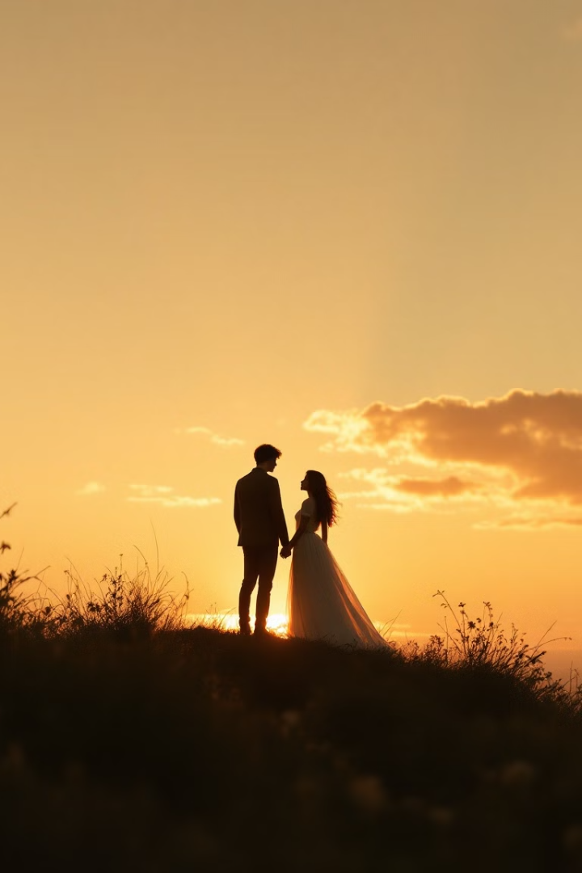



Emotional & Relational Themes
Friendship Lost and Found
The Secret I Never Told
Reconnect with old friends in unexpected ways
Reveal hidden truths that change everything
The Day Everything Changed
Capture life's pivotal moments

Slide 3








Fantasy & Sci-Fi Themes
Portal to Another World
The Last Robot on Earth
Everyday objects become gateways to adventure
Mechanical heart searches for purpose
The Time-Traveling Backpack
Secret Powers
Discover abilities that were always within
School supplies with unexpected powers

Slide 4






Genre-Based Prompts
Mini Mystery
Solve the case in under 3 minutes
Comedy of Errors
Small mistakes lead to hilarious consequences
Silent Film Challenge
Tell your story without words

Slide 5





Topical & Social Themes
Saving the Planet
Environmental challenges with unexpected solutions
Voices Not Heard
Spotlight on overlooked perspectives
Life in 2050
Imagine your future world
Offline for a Day
Discovery through digital disconnection

Slide 6
Visual & Style-Based Ideas
Told in Reverse
No Dialogue
One Color
Start with the ending, work backward
Actions and expressions tell everything
Design entire film around single hue
Challenge audiences to piece together the story
Use sound effects and music instead of words
Create visual impact through limitation

Slide 7

Surreal & Imaginative Themes
The Day Time Froze
Explore moments suspended between seconds
Talking Objects
What would your possessions say?
The World Without Gravity
Everything floats, nothing stays grounded
Dream or Reality?
Blur the lines between what's imagined and real

