Slide 1

^{8th} Film Festival
🎬 Make a Film. Get Seen. Win Big. 🎬
Are you a student with a passion for film? Now’s your chance!
Create a 1–3-minute short film and you could have it screened to a national audience — plus a chance to win a prize!
✅ Open to all school-aged students across the UK ✅ Any genre welcome – drama, comedy, animation… you decide ✅ Finalists will have their films shown at a special screening ✅ Winners will receive exciting prizes and national recognition
🎥 Deadline: Friday 20th June 📩 Submit your film here: https://filmfreeway.com/MoonHallSchoolFilmFestival

Slide 2

The Festival itself
Students will be able to come to school on July 4th as any film characters, there will also be interest in opportunity to win a prize.
There will be Workshops arranged for Students who express an interest in Film and Performing Art.

Slide 3
Theme
Stuck on a theme? 🎭 Take a look at our suggested themes for inspiration: 🔗 https://www.moonhallschoolreigate.co.uk/moon-hall-community/moon-hall-film-festival
Got questions or need more info? 📧 filmfest@moonhall.co.uk
Whether you film on a phone or a camera – we want to see your story.
Lights. Camera. Your moment

Slide 4
8th Film Festival
Friday 4th July
Students can dress up Film Characters, there is also a prize for best outfit. At Moon Hall School.
There will also be a variety of different themes
There will also be a showing at school
There will also be a screening in the evening for the finalist films

Slide 5
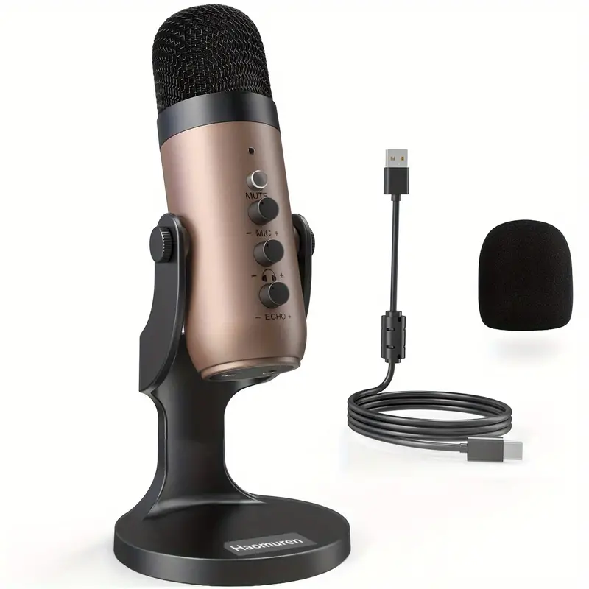



Prizes and Trophies
🏆 Main Award Categories
Best Film (Overall Winner)
Best Storytelling
Best Cinematography
Best Editing
Audience Choice Award
🎖 Special Mentions
Best Comedy
Best Horror/Thriller
Best Animation
Most Creative Idea
Rising Star (for effort and potential)
This Photo by Unknown Author is licensed under CC BY-SA

Slide 6
Rules for Film Festival
Eligibility: The film festival is open to all students aged 8 to 16 years old at Moon Hall School including other schools who have been invited.
Film Duration: Films or animations must be no longer than (3 Minutes) in duration.
Theme: Films Any film ideas, please all at the themes on websites. Although students are free to make any type of film.
Content: Films must be appropriate for all ages and must not contain any violence or adult themes.
Originality: Films must be the original work of the student or group of students submitting the film.
Credits: All films must include credits at the end, which must include the names of all participants and their roles in the making of the film.
Format: Films must be submitted in a digital format, such as mp4 or mov. A Films to be recorded and edited in HD or 4K formats and in 16:9 aspect ratio (wide screen).
All submitted films, should be sent via OneDrive or WeTransfer must allow downloading by us in HD or 4K formats an in 16:9 aspect ratio.

Slide 7
Rules for Film Festival
Submission: Films must be submitted by the submission deadline by June 20th 2025.
All submitted films via Freeway Film Festival.
Judging: Films will be judged by a panel of judges, and the decisions of the judges will be final.
Awards: Awards will be presented to the winners of the festival, which will include categories such as Best Film, Best Director, and Best Screenplay. Best Animation, Prizes will be TBC.
All films should use the English language. However, foreign language films that incorporate full English subtitles are permitted.
You are responsible for the content of your film. Therefore, you must ensure that the sound, music, and picture quality are cleared for public viewing.
All films will be reviewed by our panel and a selection of the best will be shown at the screening.

Slide 8

How to start off to make a film of choice

Slide 9

Pivot Animator
Type: Stick Figure Animation Software
Website: pivotanimator.net
Features: Easy-to-use stick figure animation tool; frame-by-frame animation with onion skinning; simple and intuitive interface; ability to create and import custom stick figures and backgrounds.
Platforms: Windows
Animation software used in school.
This Photo by Unknown Author is licensed under CC BY-ND

Slide 10

Stop Motion Studio
Features: Create stop motion animations, overlay mode for easy positioning, frame-by-frame editor, green screen support, audio effects and voice recording.
Download: Stop Motion Studio on App Store
IPAD and Iphone

Slide 11
Cap-Cut – Video Editing – Free Software
🎬 CapCut - Your All-in-One Video Editor! Edit like a pro with CapCut — the ultimate free video editor for creators! Add effects, transitions, music, auto captions, and more with just a few taps. Perfect for TikToks, Reels, YouTube videos, or cinematic edits. ✨ Easy to use | 🎵 Trending sounds | 🪄 AI tools | 📱 Mobile-friendly
https://www.capcut.com/

Slide 12


Free Software Here are some popular free video editing software options, suitable for various platforms
Features: Professional-level editing, colour correction, visual effects, and audio post-production; multi-user collaboration; supports 8K editing.
Platforms: Windows, macOS, Linux
Download: DaVinci Resolve
Shotcut
Features: Wide format support, native timeline editing, multi-track timeline, advanced audio filters, and video effects; 4K resolution support.
Platforms: Windows, macOS, Linux
Download: Shotcut
HitFilm Express
Features: Professional-grade video editing and visual effects; compositing tools; built-in animations; over 400 presets and effects.
Platforms: Windows, macOS
Download: Hit Film Express
DaVinci Resolve

Slide 13
Free Video editing software
OpenShot
Features: Easy-to-use interface, supports unlimited tracks, advanced timeline, keyframe animations, 3D animated titles and effects.
Platforms: Windows, macOS, Linux
Download: OpenShot
Lightworks
Features: Professional video editing with multi-cam editing, real-time effects, and advanced trimming; export to 720p for free version.
Platforms: Windows, macOS, Linux
Download: Lightworks
iMovie
Features: Intuitive interface, supports 4K video, built-in templates and themes, seamless integration with Apple devices.
Platforms: macOS, iOS
Download: iMovie

Slide 14
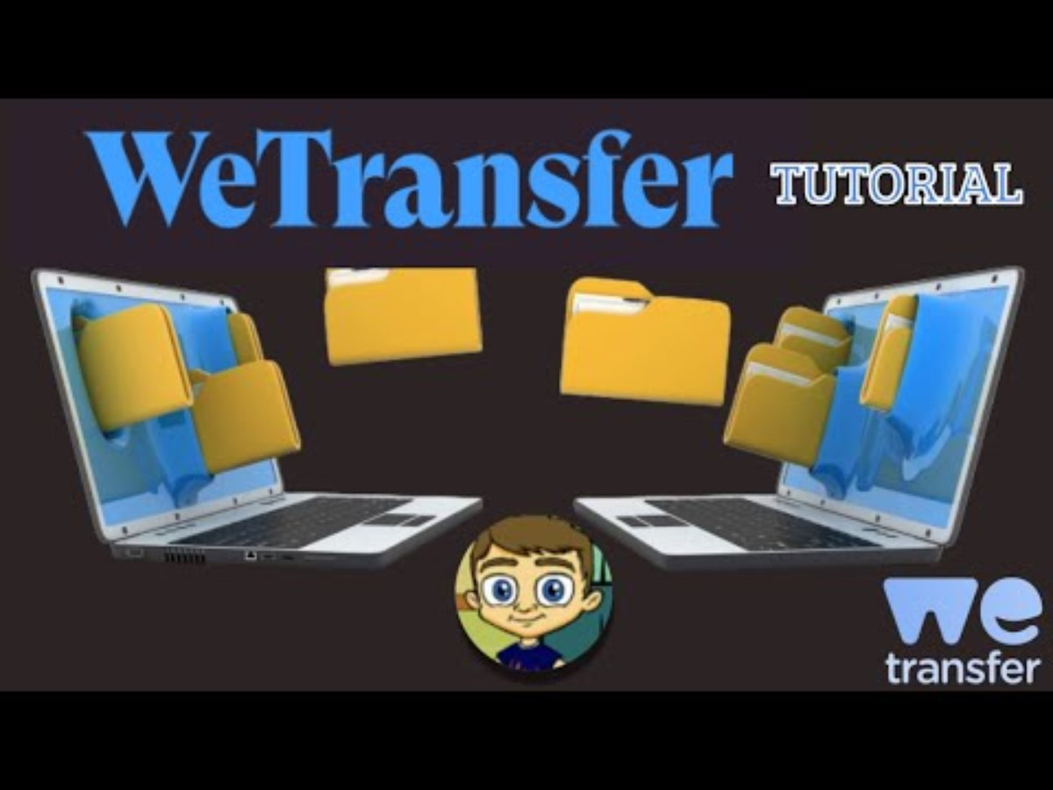
How to Send Videos to besimh@moonhall.co.uk
Watch the tutorial
How to upload and share your video.
WeTransfer Tutorial - Transfer Large Files Online (youtube.com)
How to share on onedrive
Office 365 - Sharing a OneDrive File & Setting Permissions (youtube.com)

